Slide 1
Date: 04 November 2025

Slide 2
Weekly Presentation : Rotor Bearing System
Week number: 06
Date: 04/11/2025
Supervisor: Prof. Peter Quell
Group members: Divyesh Mistry, Venkata Sreekanth .K , Sreehari Padachery, Jill Sadariya
Presenter : Venkata Sreekanth .K

Slide 3
Agenda
Task of the week.
Scaling : SKF Spherical Roller Bearing (Cylindrical Bore)
Load Equilibrium in a 3-Point Suspension System.
Reference : SKF Spherical Roller Bearing (Cylindrical Bore).
Bolted Flange Connection between Rotor Shaft and Rotor Hub.
Bibliography.

Slide 4
Task of the week
Scaling of Spherical roller Bearing.
Scaling of Bearing Housing.
Torque wrench Selection & calculation.
Studied the flanges at rotor hub & Gear box. Conducted a meeting with System Integrator and Gear box team regarding the Flanges ( Not added in the PPT).

Slide 5
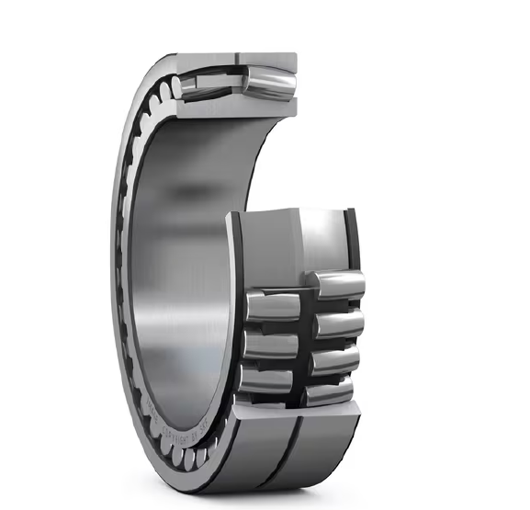
Spherical roller bearing (Cylindrical Bore)
Scaling
240/1600 CAF/W33
240/1120 CAF/W33
Source: SKF

Slide 6
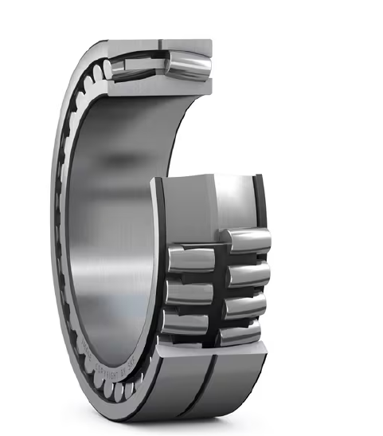
Scaling : SKF Spherical Roller Bearing (Cylindrical Bore)
Bearing Basic Dimensions
Parameter | Symbol | Original (240/1120) | Scaled × 1.4286 (1600 bore)
Bore diameter | d | 1120 mm | 1600 mm
Outer diameter | D | 1580 mm | 2257 mm
Total width | B | 462 mm | 660 mm
Pitch circle diameter | PCD | 1388 mm | 1983 mm
Roller Arrangement Geometry
Parameter | Symbol | Original (240/1120) | Scaled × 1.4286 (1600 bore) | Remarks
Rollers per row (variant A/B) | n | 32 / 65 | 32 / 65 | 2 rows → 64 or 130 total
Angular spacing | θ | 11.25° / 5.538° | same | Angles don’t scale
Chord (center–center) | c ≈ | 136 mm / 67 mm | 194 mm / 96 mm | Linear × 1.4286
Arc distance (along PCD) | s = π·PCD/n ≈ | 136.3 mm / 67.1 mm | 194.7 mm / 95.8 mm | ≈ c for large PCD
Source: SKF

Slide 7
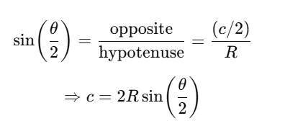
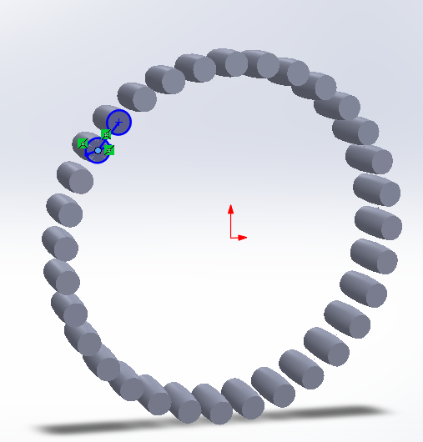



chord-length formula
Symbol |  | Units
c | Straight-line distance between adjacent roller centers (the chord) | mm
θ | Angular spacing between those rollers, (360°/n) | degrees
R | Radius of the circle through the roller centers | mm
PCD | (2R) — the diameter of that circle | mm
Pitch-circle diameter (PCD)
PCD=2R,
240/1120 CAF/W33
Source: SKF
Arc distance (s) = the distance along the circular path (the pitch circle) between the centers of two adjacent rollers

Slide 8
Roller & Cage Core Dimensions
Parameter | Symbol | Original (240/1120) | Scaled × 1.4286 (1600 bore) | Notes
Roller diameter | Dᵣ≈ | 100 mm | 143 mm | Linear scale
Roller length | Lᵣ≈ | 186 mm | 266 mm | Corrected length scaled
Cage inner Ø | ≈ | 1220 mm | 1743 mm | Inner-ring guided
Cage outer Ø | ≈ | 1480 mm | 2114 mm | Between raceways
Lubrication & Material
Parameter | Symbol / Meaning | Original (240/1120) | Scaled × 1.4286 (1600 bore) | Notes
W33 groove width |  | 12 mm | 17 mm | Lubrication groove
W33 groove depth |  | 5 mm | 7 mm | Lubrication groove
Materials |  | Bearing steel / brass (CA) | Same | Design unchanged

Slide 9
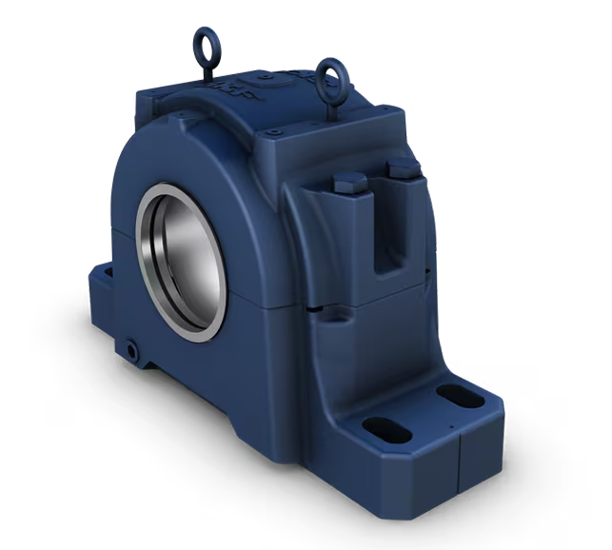
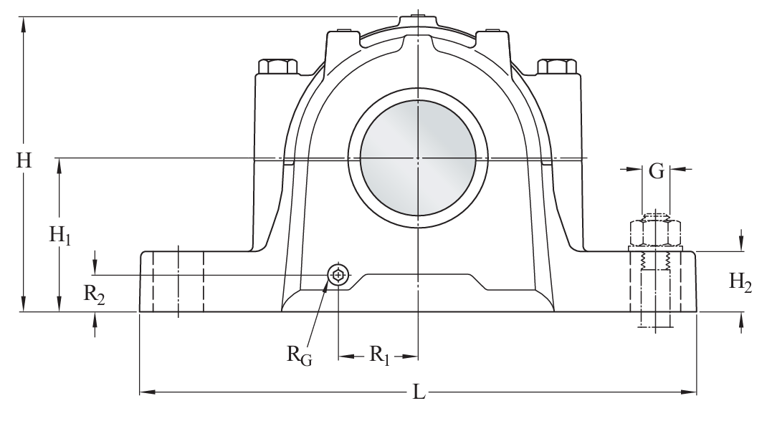
Scaling : Bearing Housing
Case-1
SAF 240 Split plummer (pillow) block housing without bearing
Outer Diamter of bearing Housing :360mm
Bearing Seat width : 107.798mm
Total Length of bearing Housing : 749.3mm
Total width of bearing Housing : 285.75mm
Scaling factor :
Total Length of bearing housing for Syria =(2257mm/360mm) * 749.30mm
= 4697 mm
Total width of bearin Housing for Syria =
=(660mm/107.798mm)*285.75 mm
=1750mm
Source: SKF

Slide 10
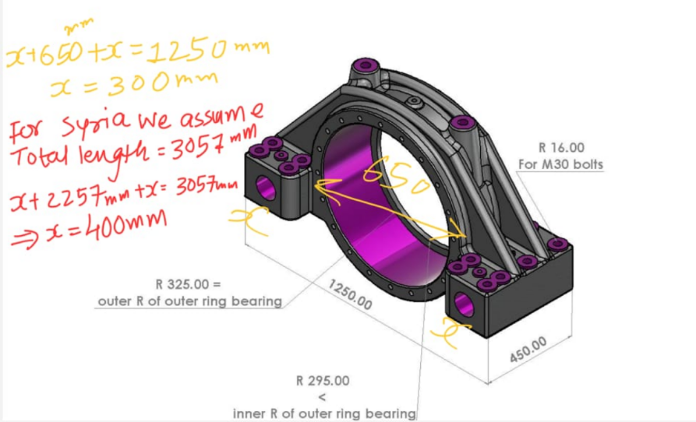
Case-2
Scaling based on Optimus 60E
Outer Diamter of bearing Housing :650mm
Bearing Seat width : 212mm
Total width of bearing Housing : 270mm
Width of Legs:450mm
Total Length of bearing Housing : 1250mm
Scaling factor :
Total Length of bearing housing for Syria =(2257mm/650mm) * 1250mm
= 4340 mm
Total width of bearin Housing for Syria =
=(270mm/212mm)*660 mm
=1400mm
Source: Optimus 60E
Case-3
Purely based on our assumption we take Total length of housing as 3057mm which is within tower top diamer (3800mm) .
Total width of housing around 1400mm
T

Slide 11
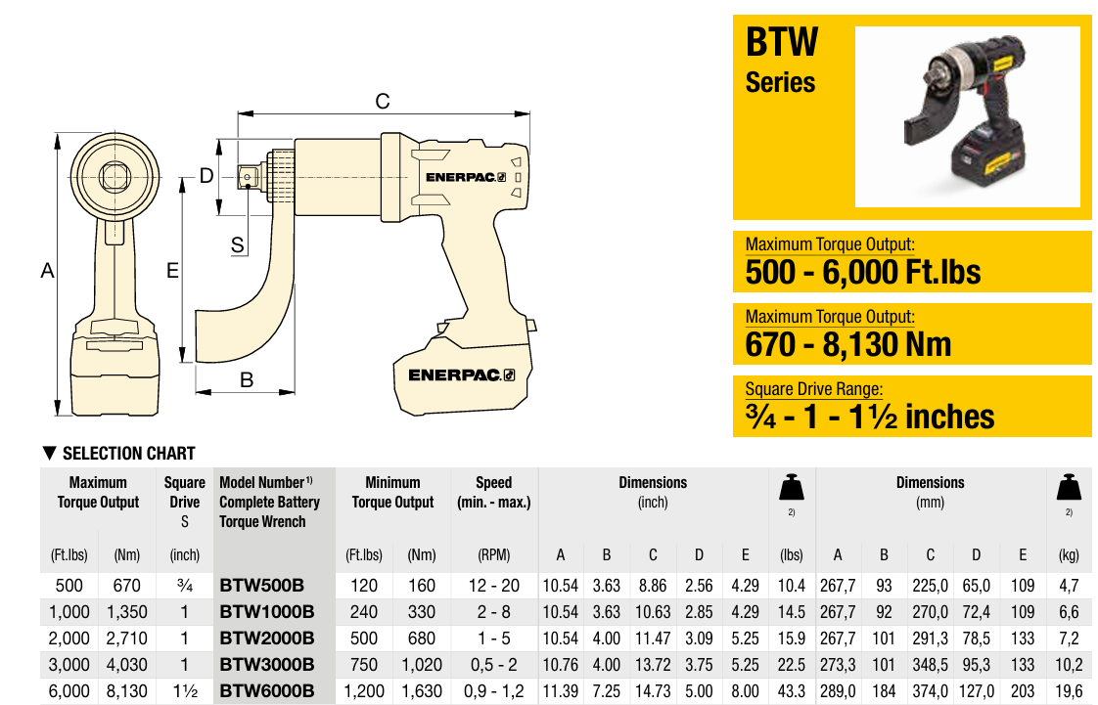
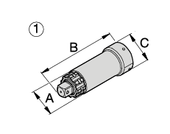
Battery Torqure wrench for M39 bolts
Description | Value
Diameter of the socket at hexagonal head side of the Bolt (C) | 102 mm
Diameter of the socket at Anvil of (A) | 84 mm
Source: ENERPAC

Slide 12
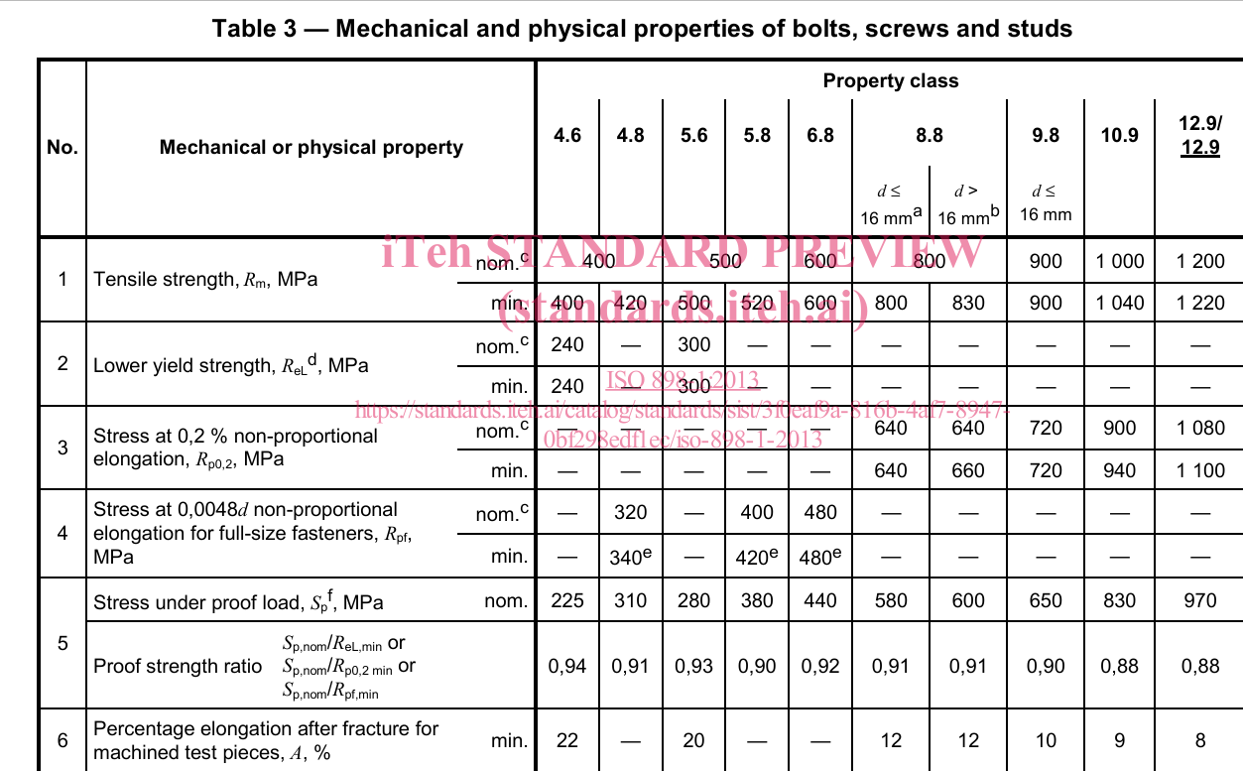

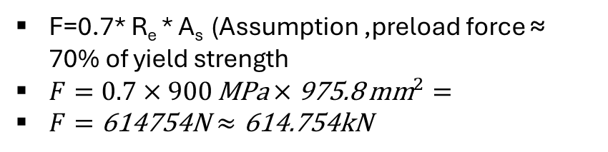

ISO 898-1:2013
 |  | Grade 10.9
Ultimate tensile strength | R_{m} | 1000 MPa
Yield strength | R_{e} | 900MPa
Proof load stress | S_{p} | 830MPa
R_{e} /R_{m} =0.9
A_{s}=
$\frac{π}{4}$(${d−0.9382P)}^{2}$
$=\frac{π}{4}$(${39−0.9382∗4)}^{2}$
= 975.8 mm²
F=0.7* R_{e} ​* A_{s} (Assumption ,preload force ≈ 70% of yield strength
$F=0.7×900 \text{MPa}×\text{975.8} {\text{mm}}^{2}=$
$F=\text{614754}\text{N}≈\text{614.754}\text{kN}$
Tightening torque T=K×F×d =0.25*614.754*.039
= 5.993 KNm
K = nut factor (depends on lubrication , Assuming dry k=0.25)
d = nominal diameter (m)
Source: ISO 898-1:2013

Slide 13
Bibliography – Rotor Bearing System
SKF. (n.d.). SAF 240 - Bearing housings. Retrieved October 30, 2025, from https://www.skf.com/group/products/mounted-bearings/bearing-housings/split-pillow-blocks-saf-saw-series/productid-SAF 240
SKF. (n.d.). 240/1120 CAF/W33 - Spherical roller bearings. Retrieved October 29, 2025, from https://www.skf.com/group/products/rolling-bearings/roller-bearings/spherical-roller-bearings/productid-240%2F1120 CAF%2FW33
Optimus Shakti, Optimus 60E
Enerpac. (n.d.). BTW-Series: Battery torque wrench, square drive. Retrieved October 31, 2025, from https://www.enerpac.com/en-us/btw-series-battery-torque-wrench.
International Organization for Standardization (ISO). (2013). ISO 898-1:2013 – Mechanical properties of fasteners made of carbon steel and alloy steel – Part 1: Bolts, screws and studs with specified property classes — Coarse thread and fine pitch thread. Retrieved October 31, 2025, from https://standards.iteh.ai/catalog/standards/sist/3f0eaf9a-816b-4af7-8947-0bf298edf1ec/iso-898-1-2013

